Slide 1
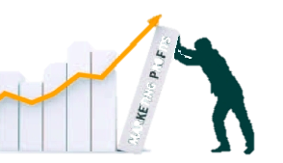
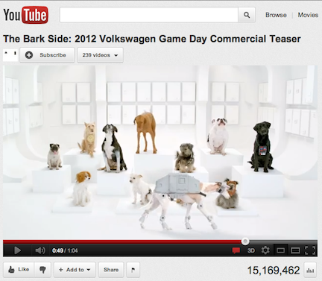
Marketing Communications, Social Media, and Customer Response
MBM6
Chapter 10
Chapter 10
Marketing Communication Objectives
Digital Marketing Communications
Social Media Marketing
Marketing Communications and Customer Response
Marketing communications need a measurable customer-response objective in order to be justifiably effective.
Copyright Roger J. Best, 2012

Slide 2
Marketing Communications, Social Media, and Customer Response
MBM6
Chapter 10
Marketing Communication Objectives
In this section we will look at how most marketing communications can be placed in one of three broad categories according to their objectives—brand-image, brand-information, or brand-action communications.
Copyright Roger J. Best, 2012

Slide 3
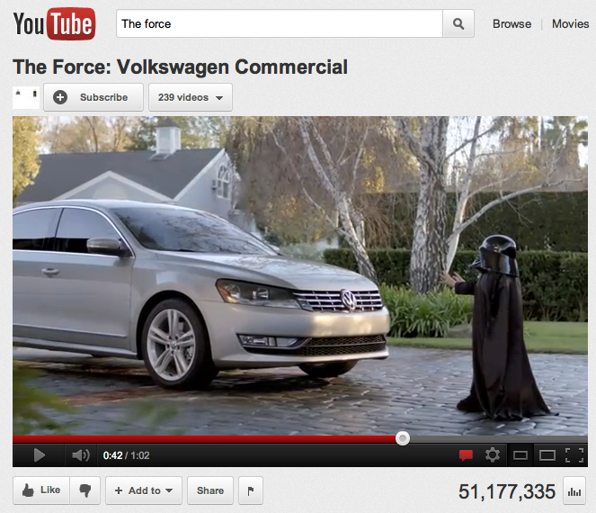
Marketing Communications, Social Media, and Customer Response
MBM6
Chapter 10
The Force was posted 4 days prior to Super Bowl XLV. Prior to the game, there were over 10 million views, 10,000 comments, and 62,000 “likes.”
The Force aired during the Super Bowl, gaining an estimated 100 million impressions.
During the week following the game, another 18.5 million people viewed The Force on YouTube.
How effective do you think this tactic was for VW? Do you think that this will change the way marketers think about traditional media spend?
Copyright Roger J. Best, 2012

Slide 4
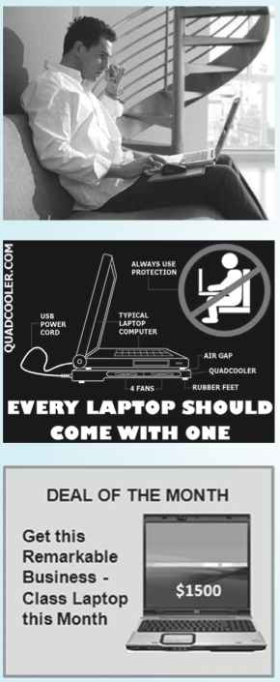
Brand Communication Objectives
MBM6
Chapter 10
■ Brand-Image Communications—designed to trigger an emotional response that builds a strong connection between the brand and the image the company wants to create among its target customers.
■ Brand-Information Communications—designed to create interest and offer information in order to achieve high recall among target customers of key product attributes that differentiate the brand.
■ Brand-Action Communications—designed to stimulate potential customers to take action, such as contacting the company, visiting the company’s web site, obtaining a free sample, and trying or buying the company’s product.
Copyright Roger J. Best, 2012

Slide 5

Brand-Image Communication
MBM6
Chapter 10
What impact does this Nike brand-image marketing communication have on you? Does it solicit an emotional response and form a positive association between the brand and performance?
Copyright Roger J. Best, 2012
Notes:
This ad is a brand-image marketing communication that seeks to tie the Nike brand name with an emotional response and form a positive association between the brand and performance.

Slide 6
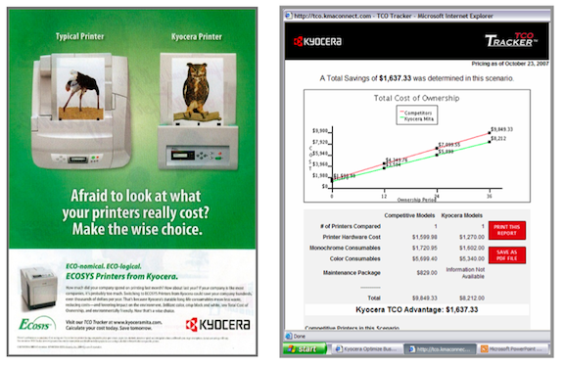
Brand-Information Communication
MBM6
Chapter 10
What information does Kyocera want you to take away from this print ad?
Copyright Roger J. Best, 2012
Notes:
The objective of the print ad is to inform target customers of the cost savings that a Kyocera printer offers over its product life relative to competing printers.

Slide 7
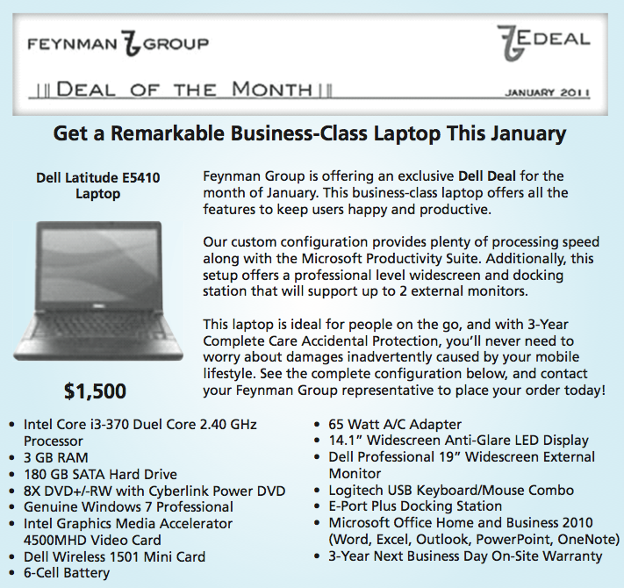
Brand-Action Communication
MBM6
Chapter 10
What action would the Feynman Group like you to take after reading this email?
Copyright Roger J. Best, 2012

Slide 8
Marketing Communications, Social Media, and Customer Response
MBM6
Chapter 10
Digital Marketing Communications
In this section we will look at how the explosion in digital and social media marketing has been the most significant change in marketing communications since the pre-television era—and what that means for marketers.
Copyright Roger J. Best, 2012

Slide 9
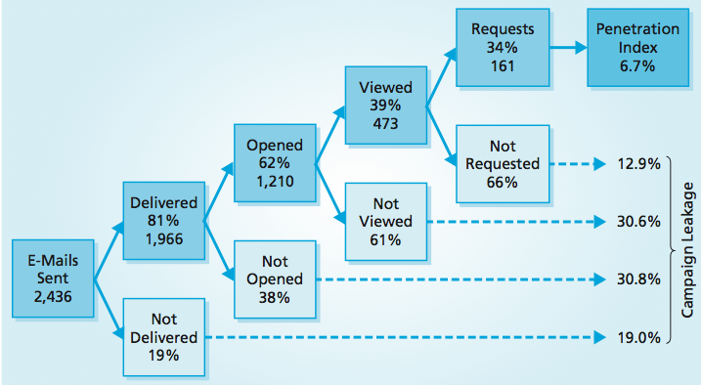
Digital Communication and
Performance Metrics
MBM6
Chapter 10
The figure below shows the results of an e-mail campaign that was designed to generate leads by targeting managers at Fortune 500 companies.
This digital campaign resulted in 161 responses from recipients. How would you characterize this level of performance?
Copyright Roger J. Best, 2012

Slide 10
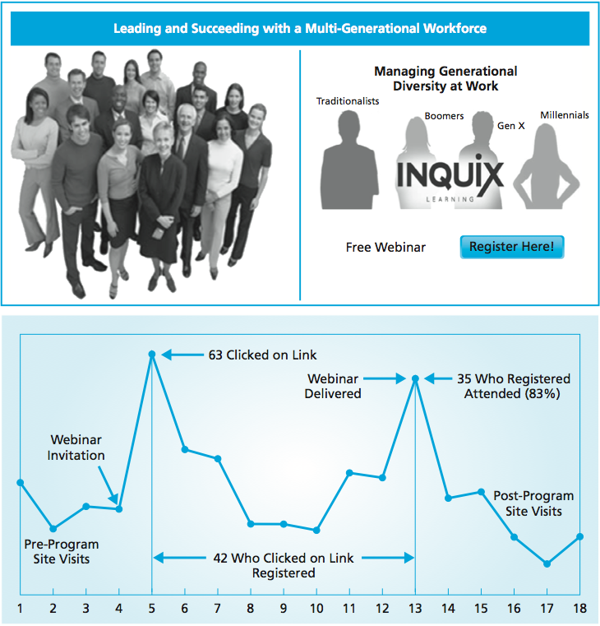
Digital Communication and
Performance Metrics
MBM6
Chapter 10
This is an example of an email campaign intended to motivate recipients to participate in a webinar.
Web traffic spiked after the e-mail was sent, resulting in 63 click-throughs that led to 42 actual registrations.
Of the 42 registrants, 35 participated (83%), and several attended a subsequent face-to-face fee-based workshop on the topic.
Copyright Roger J. Best, 2012

Slide 11
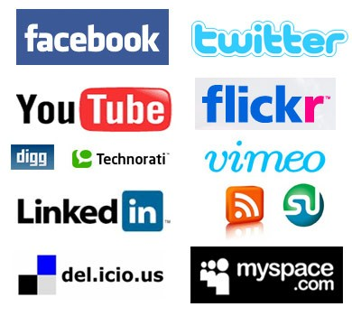
Social Media Marketing Objectives and Outcomes
MBM6
Chapter 10
■ Brand Building—Deepen customer relationships and engage in conversations with the brand community.
■ Information Exchange—Share experiences and exchange information to encourage word-of-mouth and to better understand product usage and benefits.
■ Problem Solving—Gather customer feedback, provide customer service, and resolve customer complaints.
Copyright Roger J. Best, 2012

Slide 12
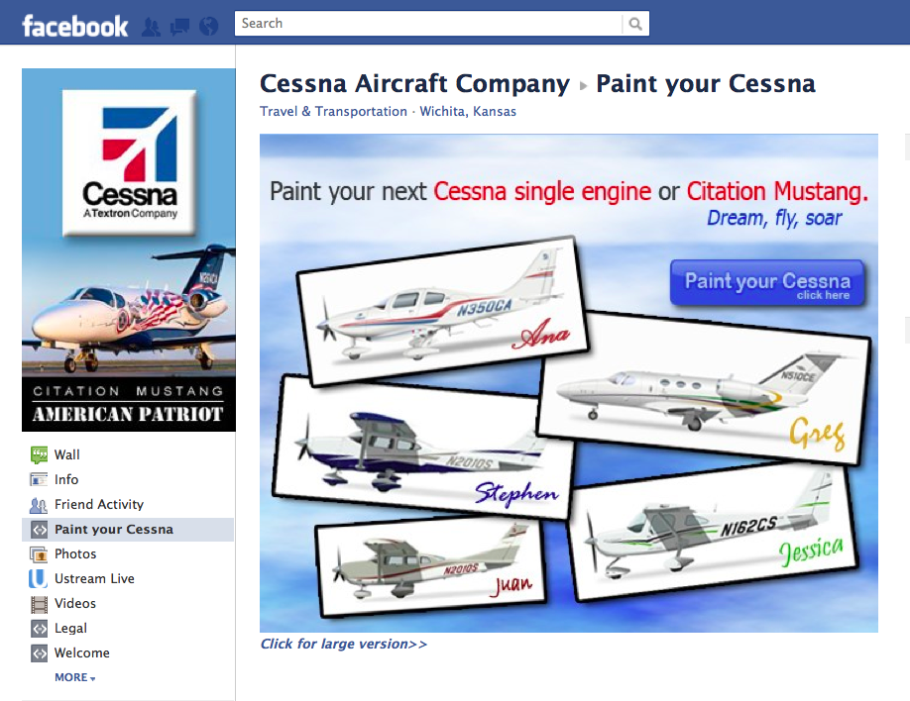
Cessna – Leveraging Facebook
MBM6
Chapter 10
Why should a business like Cessna engage their customers on various social media platforms?
Copyright Roger J. Best, 2012

Slide 13
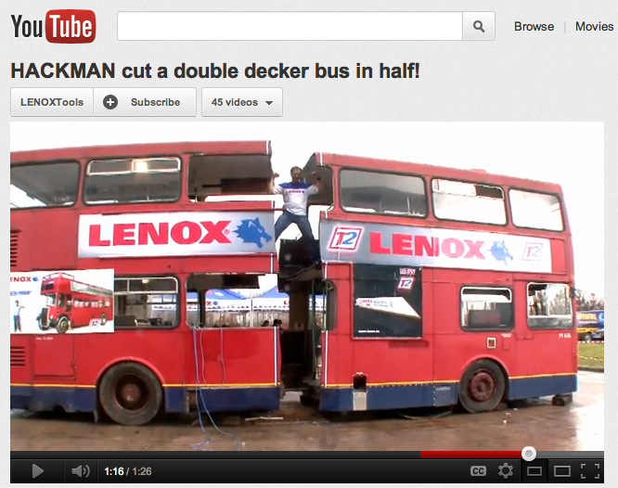
Lenox - YouTube Brand-Building
MBM6
Chapter 10
What is the benefit of using a YouTube Channel for Lenox Tools? Are there any potential downsides? Does it vary by industry?
Copyright Roger J. Best, 2012
Notes:
The YouTube video shown in Figure 10-9 is less than 2 minutes long. It shows a Lenox industrial saw being used to cut a double-decker bus in half without the need to replace the blade

Slide 14
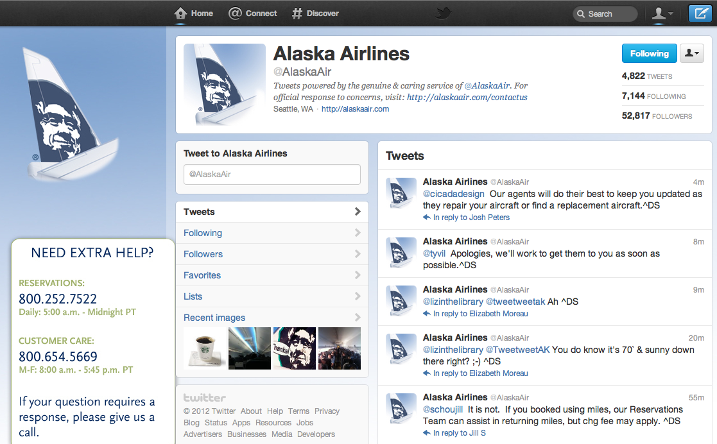
Alaska Air – Leveraging Twitter
MBM6
Chapter 10
What could other companies or industries learn from Alaska Air’s use of Twitter?
Copyright Roger J. Best, 2012
Notes:
Alaska Air uses Twitter to personalize messages to customers, simultaneously informing them about “great deals” to and from their hometowns.

Slide 15
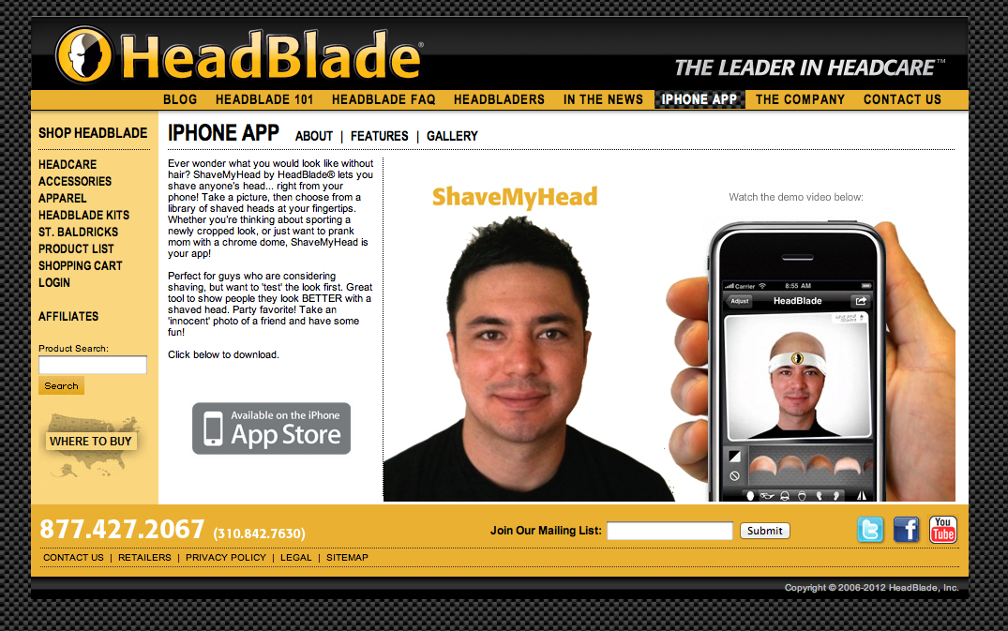
HeadBlade – Leveraging Apps
MBM6
Chapter 10
To build brand awareness, HeadBlade created an iPhone app to engage curious prospective customers by letting them see photos of themselves with a shaved head.
Copyright Roger J. Best, 2012

Slide 16
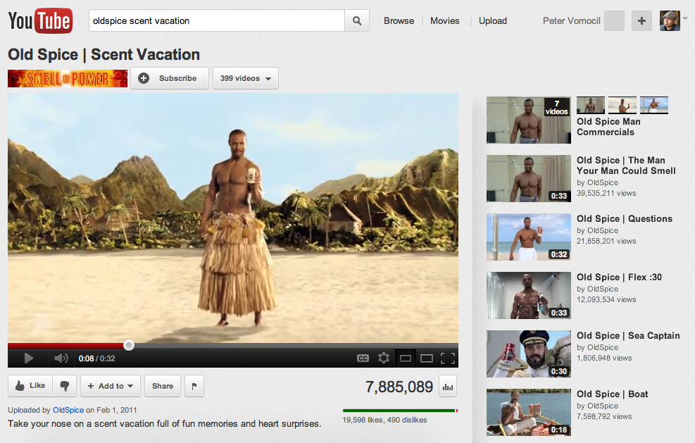
Old Spice – Viral Videos
MBM6
Chapter 10
Sales of Old Spice Body Wash were up 27 percent following the Super Bowl in 2010, up 55 percent in the 3 months following the game, and up 107 percent in July 2010 when the YouTube videos aired.
Copyright Roger J. Best, 2012

Slide 17
Marketing Communications, Social Media, and Customer Response
MBM6
Chapter 10
Marketing Communications and Customer Response
In this section we will look at the broader issue of the effectiveness of marketing communications, regardless of the marketing venue used.
Copyright Roger J. Best, 2012

Slide 18
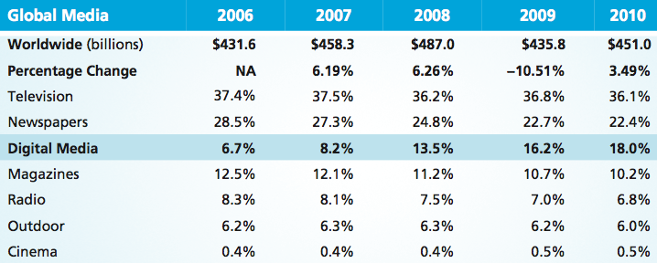
Global Media Spending 2006-2010
MBM6
Chapter 10
As a percentage of sales, spending on nearly all forms of advertising declined somewhat from 2008 to 2010, with digital advertising a notable exception. How do you think the dynamic will shift in the future?
Copyright Roger J. Best, 2012

Slide 19
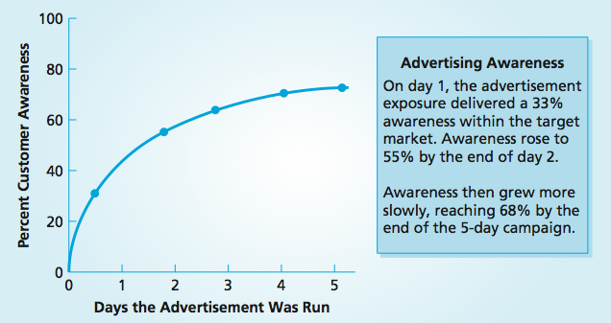
Ad Frequency and Awareness
MBM6
Chapter 10
In order for a marketing communication to have any chance of achieving its customer-response objective, it must have some level of message frequency.
Copyright Roger J. Best, 2012

Slide 20
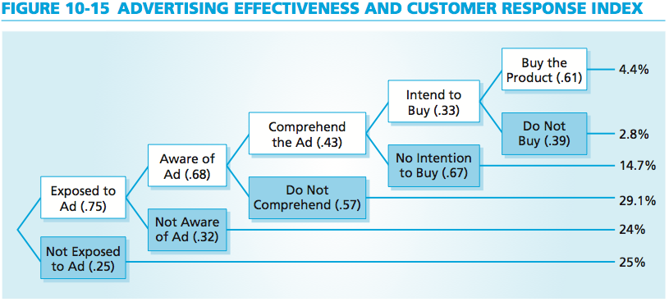
Marketing Performance Tool 10.1
Advertising and Customer Response
MBM6
Chapter 10
The customer response index is based on the performance scores along the top of the customer response tree. Where should this business focus its efforts, given the results above?
Copyright Roger J. Best, 2012

Slide 21
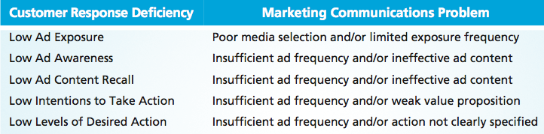

Causes of Low Customer Response
MBM6
Chapter 10
To reach target customers effectively, a business has to have a good understanding of the media habits of its target customers.
Copyright Roger J. Best, 2012

Slide 22
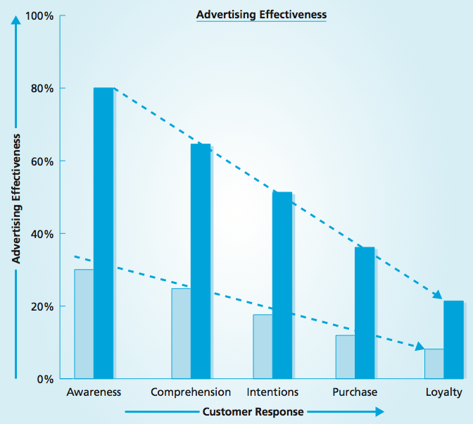
Advertising and Customer Response
MBM6
Chapter 10
For any level of awareness among potential customers, the levels of comprehension, intention, and purchase are successively lower.
Sustained profitability depends on customer retention, and each step in the hierarchy of customer response is a step toward profitability.
Copyright Roger J. Best, 2012

Slide 23
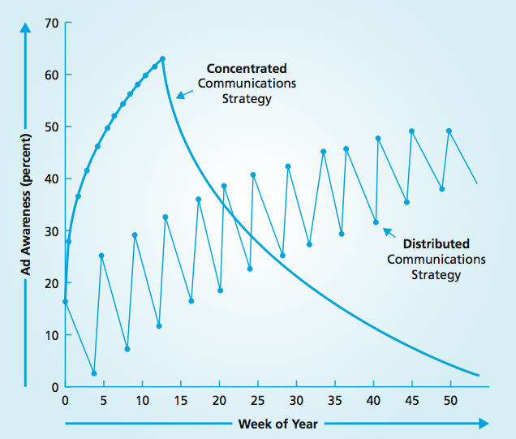
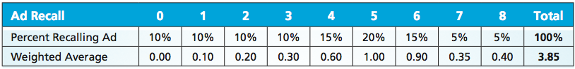
Message Frequency and Awareness
MBM6
Chapter 10
A target customer is exposed to only a fraction of the total number of messages in an advertising campaign.
Nearly all marketing communications send more messages than the target audience receives, as illustrated in the table.
Copyright Roger J. Best, 2012

Slide 24
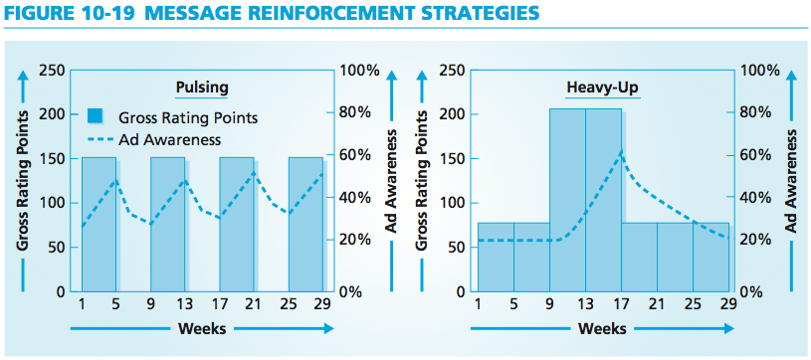
Message Reinforcement Strategies
MBM6
Chapter 10
What are examples of situations when you would want to use each of the different approaches to frequency?
Copyright Roger J. Best, 2012

Slide 25
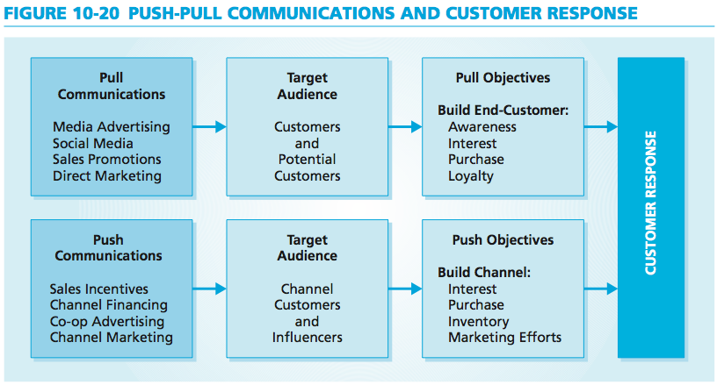
Push-Pull Communications
MBM6
Chapter 10
Customer-directed marketing communications are pull communications. Push communications are directed at channel intermediaries.
Copyright Roger J. Best, 2012

Slide 26
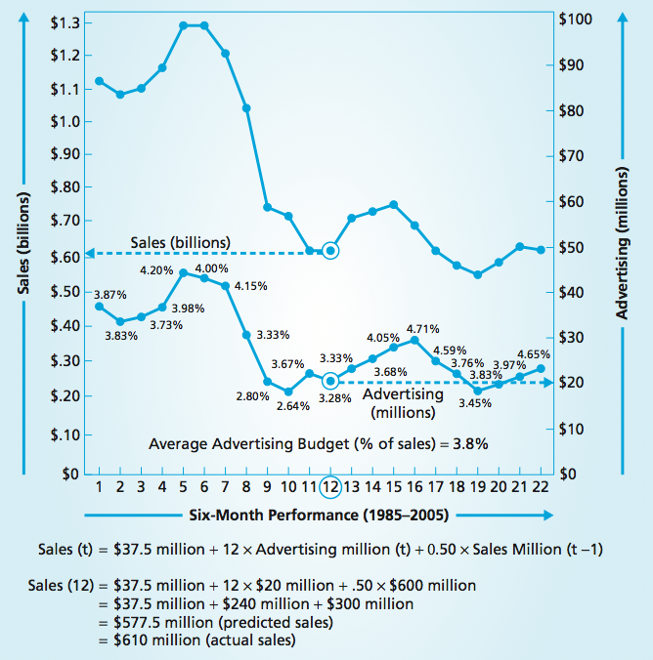


Sales-Advertising Relationship
MBM6
Chapter 10
The 0.94 correlation between advertising expenditures and sales for apparel company Hart Schaffner Marx is very high.
Copyright Roger J. Best, 2012
Notes:
Hart Schaffner Marx

Slide 27
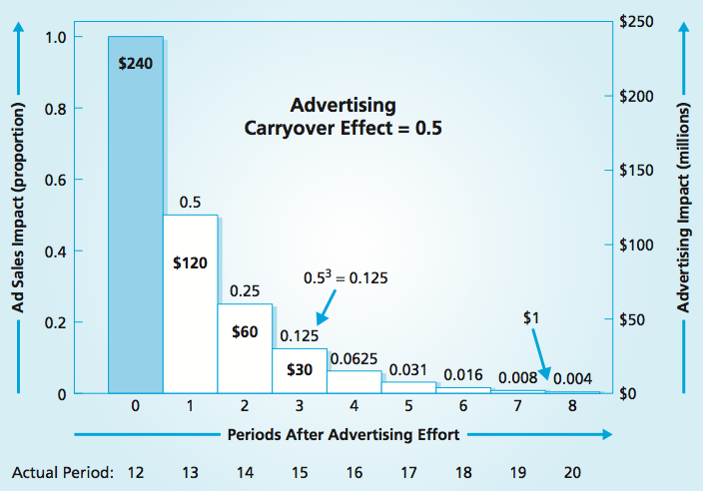
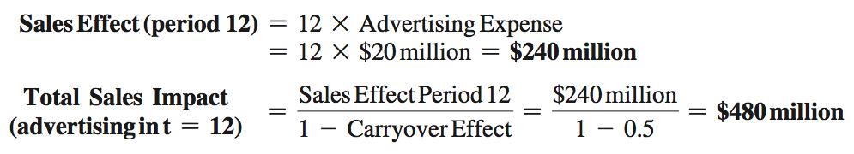
Marketing Performance Tool 10.3
Advertising and Sales Carryover
MBM6
Chapter 10
Copyright Roger J. Best, 2012

Slide 28
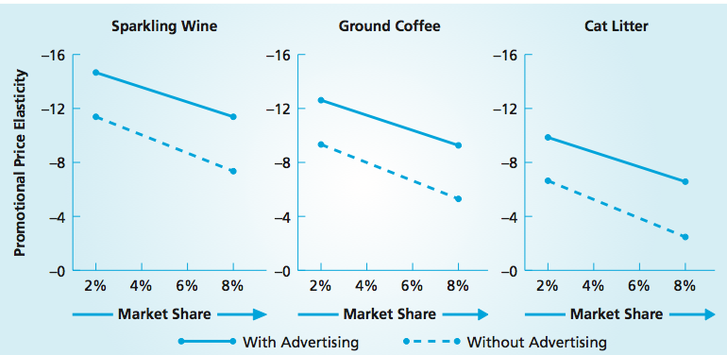
Marketing Performance Tool 10.2
Promotional Price Elasticity
MBM6
Chapter 10
The promotional price elasticity of all three products increased significantly with the use of advertising. For cat litter, this effect was very dramatic, almost doubling the promotional price elasticity.
Copyright Roger J. Best, 2012

Slide 29
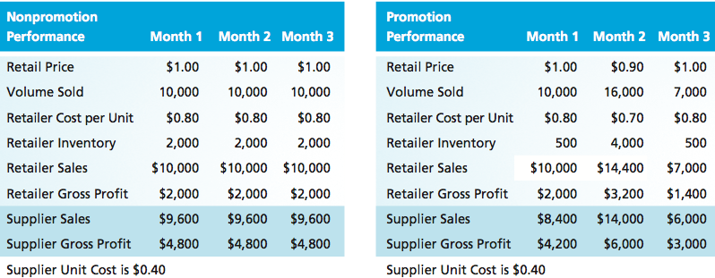
Retail Promotion Price and Sales
MBM6
Chapter 10
The idea is that the price incentive will motivate intermediaries to push the product. In many instances this strategy backfires, as intermediaries run down their inventories before a promotion and then buy more at a lower price during the promotion.
Copyright Roger J. Best, 2012

